Slide 1
Postgraduate Literacies & Research Skills Workshops
Workshop 1: Introduction
Presented by :
Tapiwa Gundu (PhD)

Slide 2
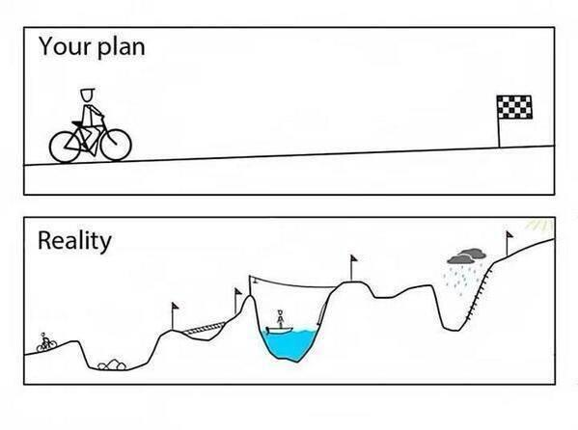
What does postgraduate research entail?

Slide 3
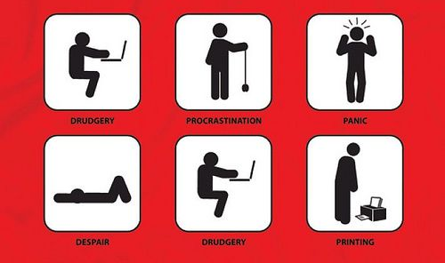
What does postgraduate research entail?......Cont

Slide 4

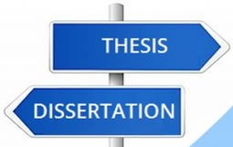
Research proposal vs Dissertation vs Thesis
research proposal is a document that a student presents to their university in order to be allowed to start writing a thesis/dissertation
Dissertation uses existing research
Thesis conducts original research

Slide 5

What skills do you need to write on postgraduate level?

Slide 6

What skills do you need to write on postgraduate level?...cont

Slide 7
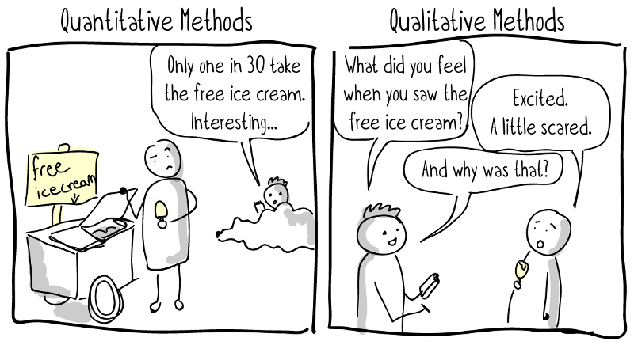
Difference between qualitative and quantitative research

Slide 8

Choosing your research topic

Slide 9
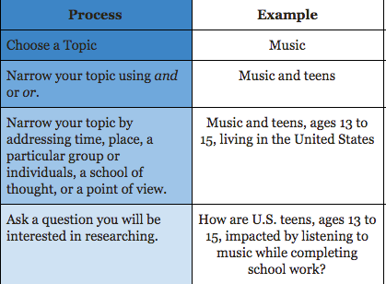
Choosing your research topic…Cont

Slide 10
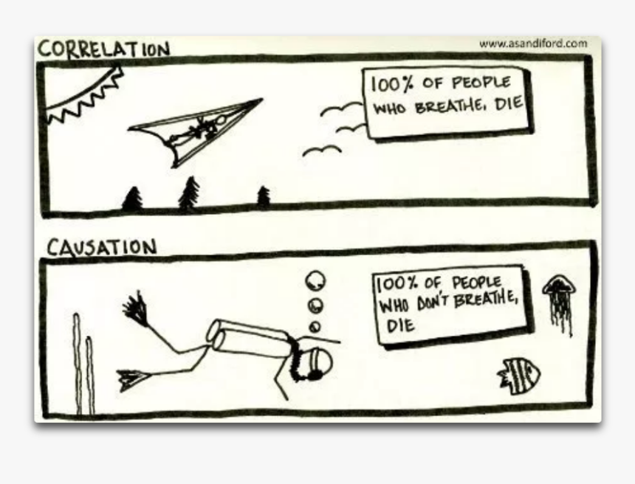
Problem statement. Research questions, objectives, hypothesis

Slide 11
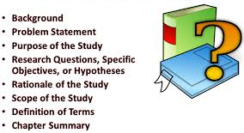
Research Proposal

Slide 12
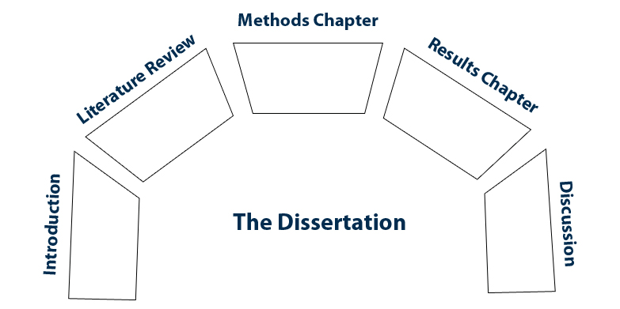
Overview of different chapters in a dissertation/thesis

Slide 13
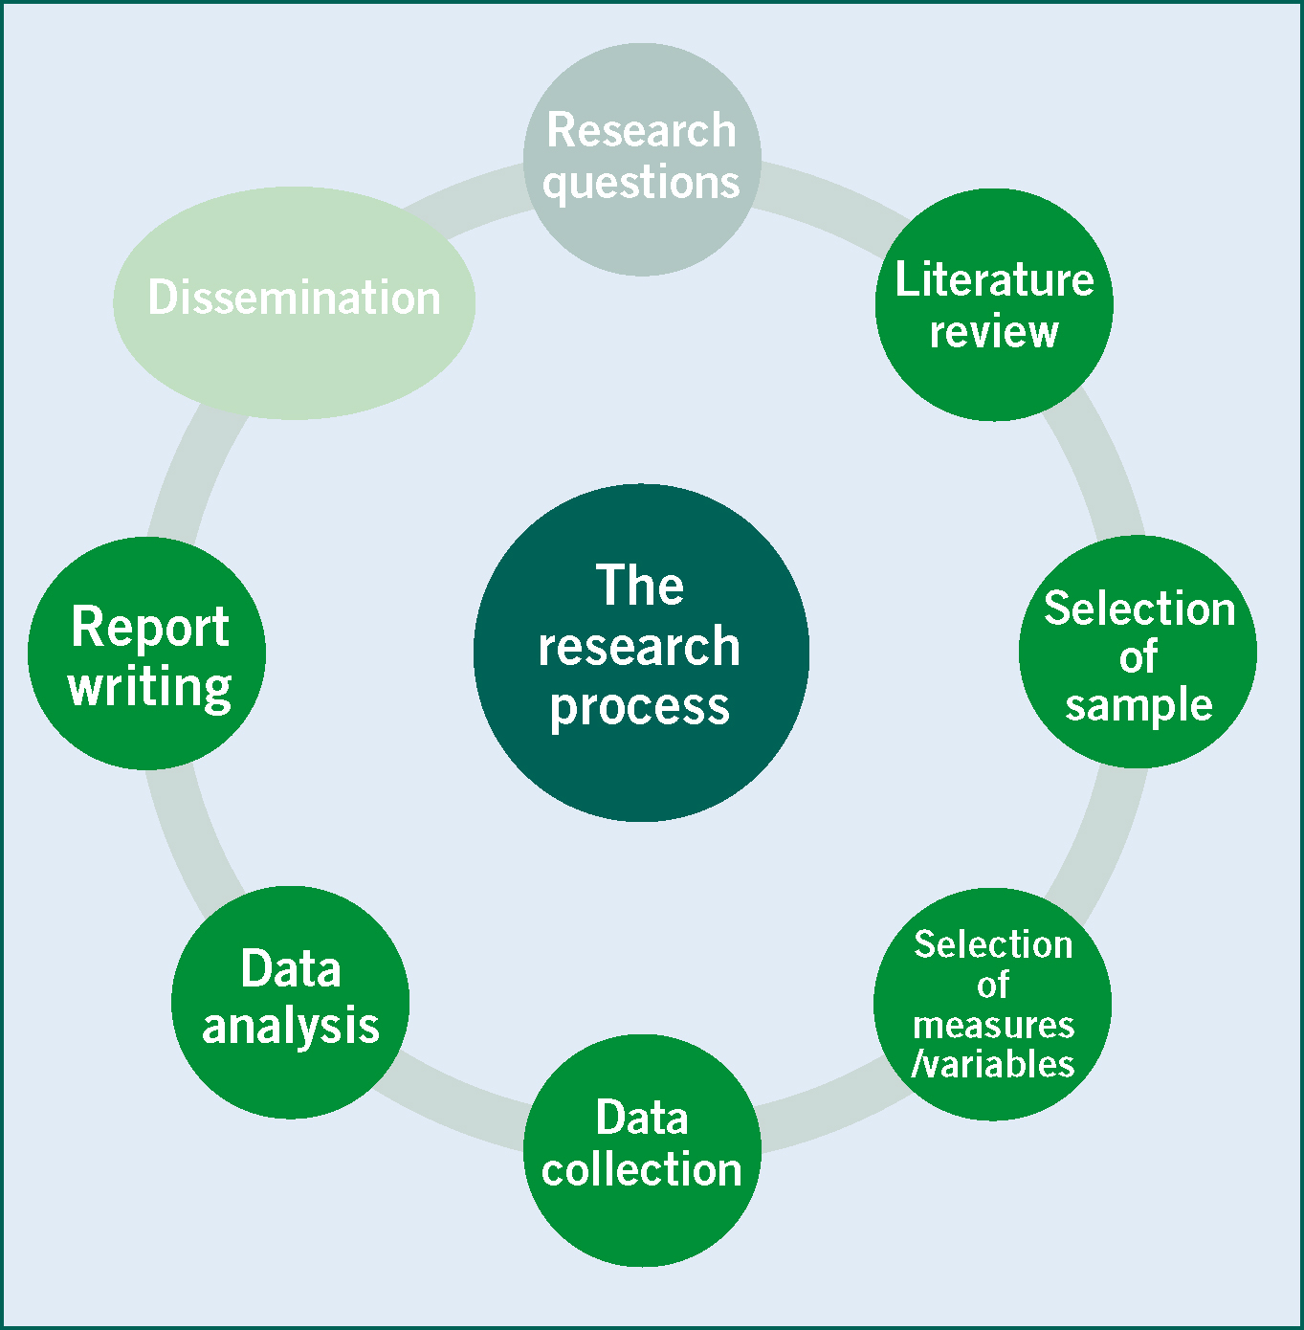
Summary

